Slide 1
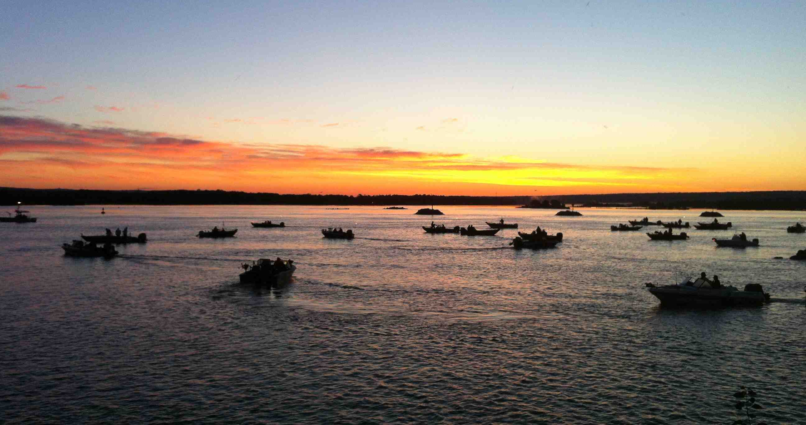
Managing Support Groups for AIS Prevention at Fishing Tournaments
Jeremy Jones & Tim Campbell, UW Sea Grant
Notes:
Short introduction to managing support groups at a fishing tournament. A “train the trainer” event.
Ask group: who has run “volunteer events”, who has run a wash station or other BMP at a tournament.

Slide 2
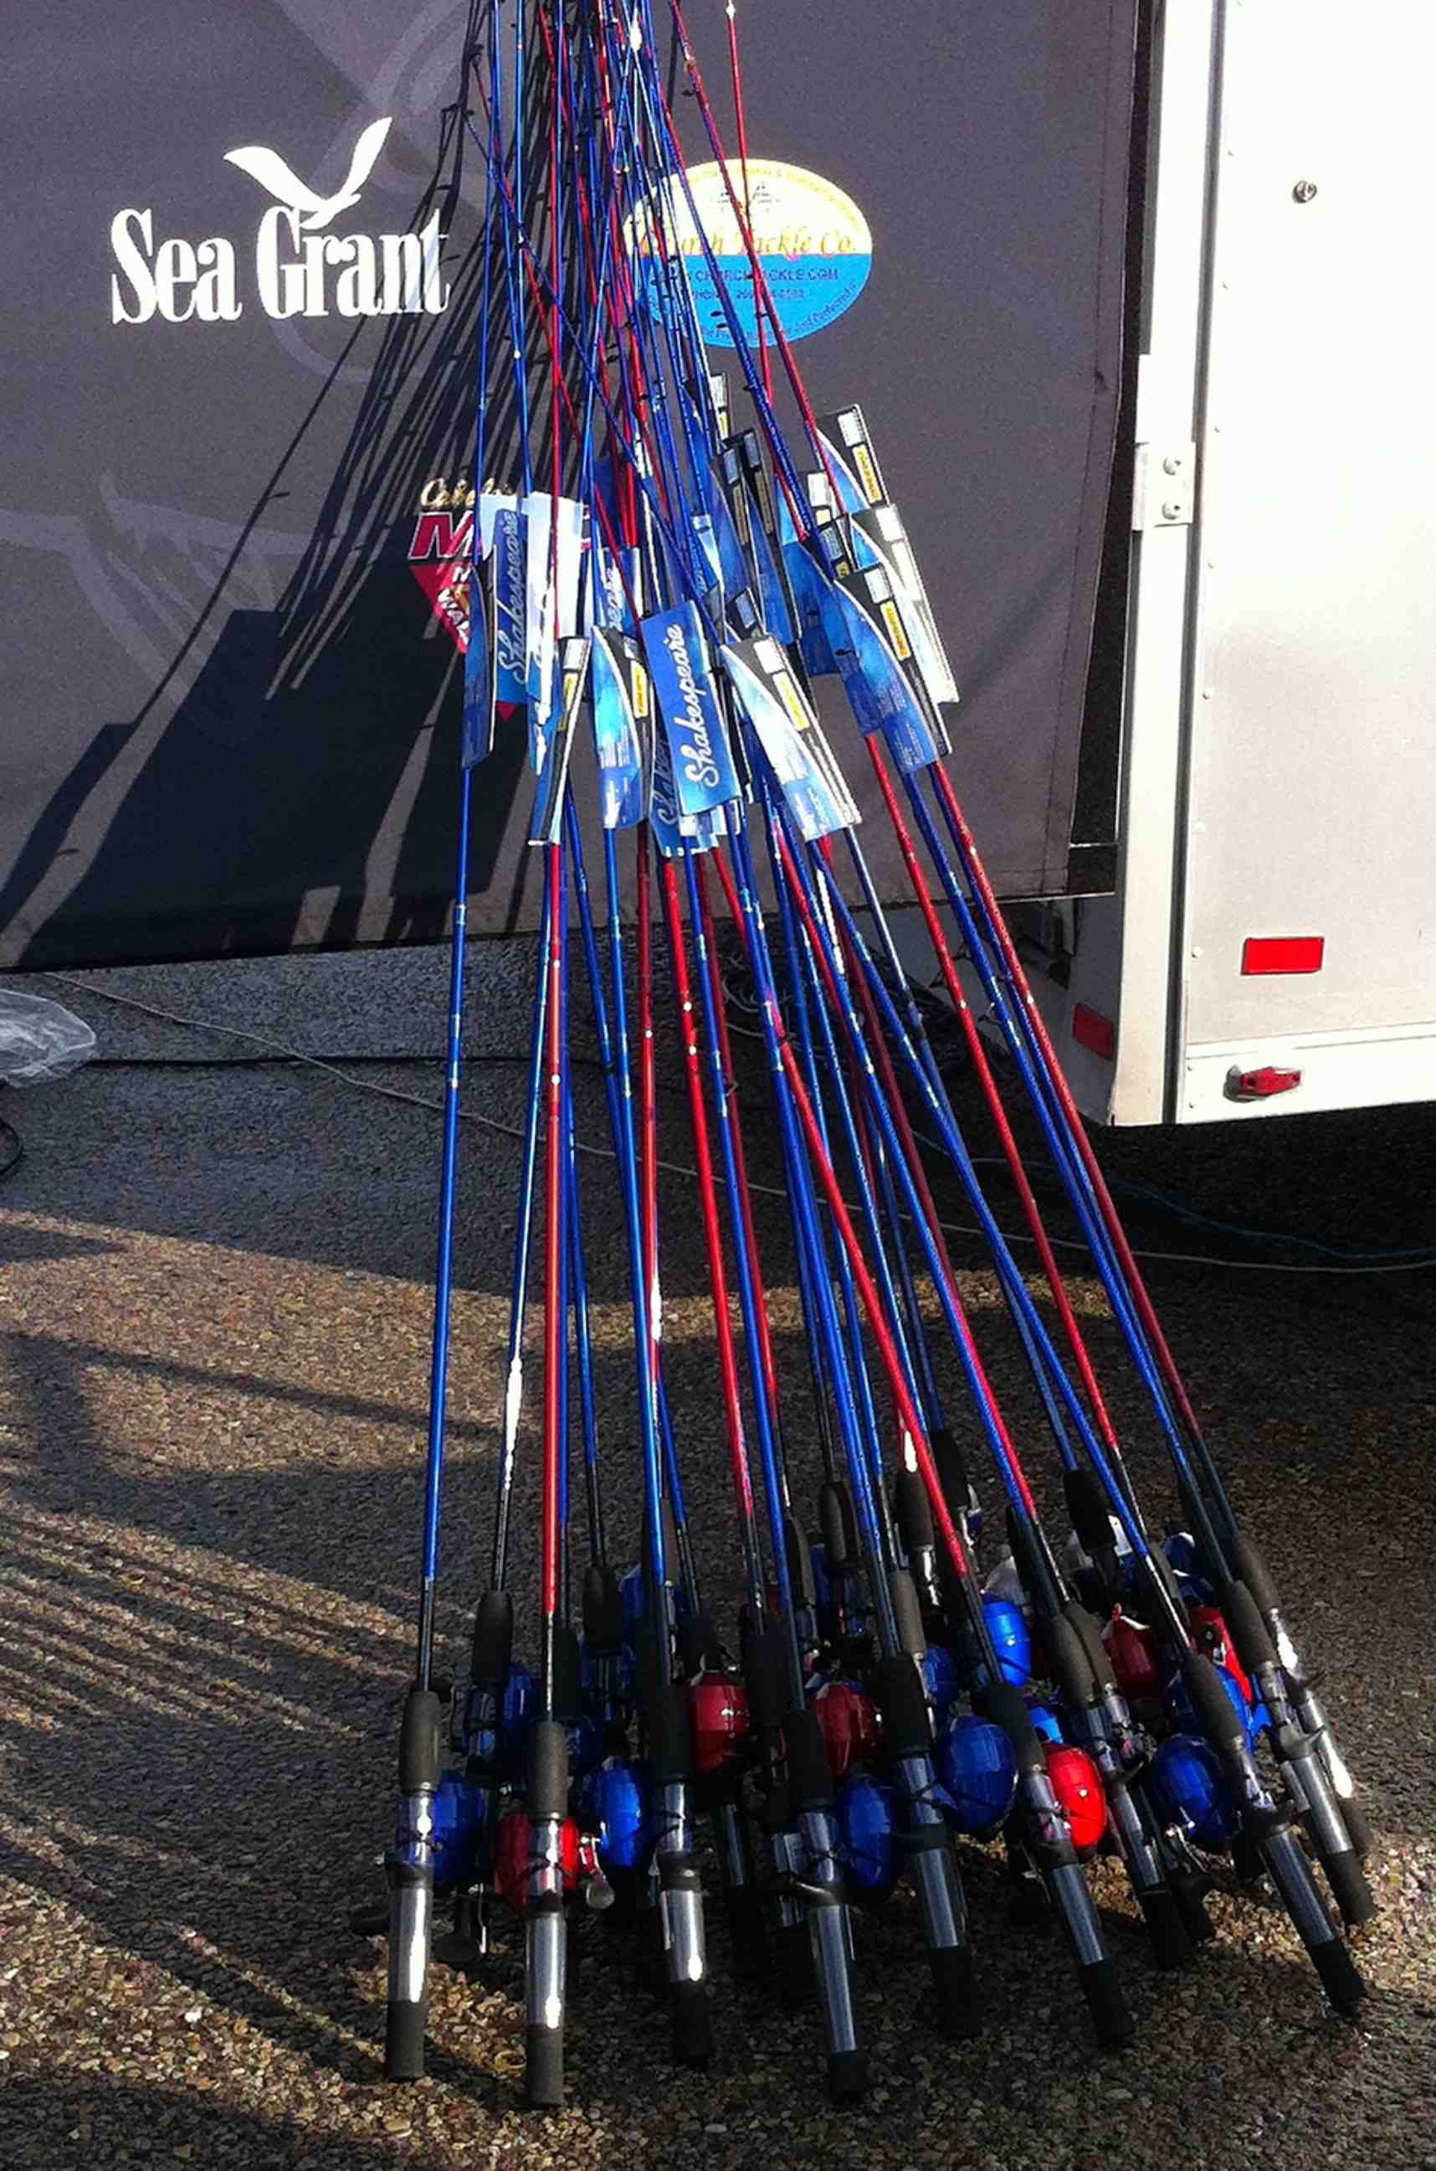
Train the Trainer Session
Who are the Support Groups?
Goals
Tips for working with Volunteers
Pre-event
During event
Post-event
Notes:
Overview for session.
My goal: To show you what we do and build on your experience for facilitating the training of support groups.
Our goal: We’re trying to create a “corps” of well trained support groups that can help implement BMP’s in their community and with fishing tournaments.
Education and Tabling are Awesome but here we’re trying to help people take action.

Slide 3
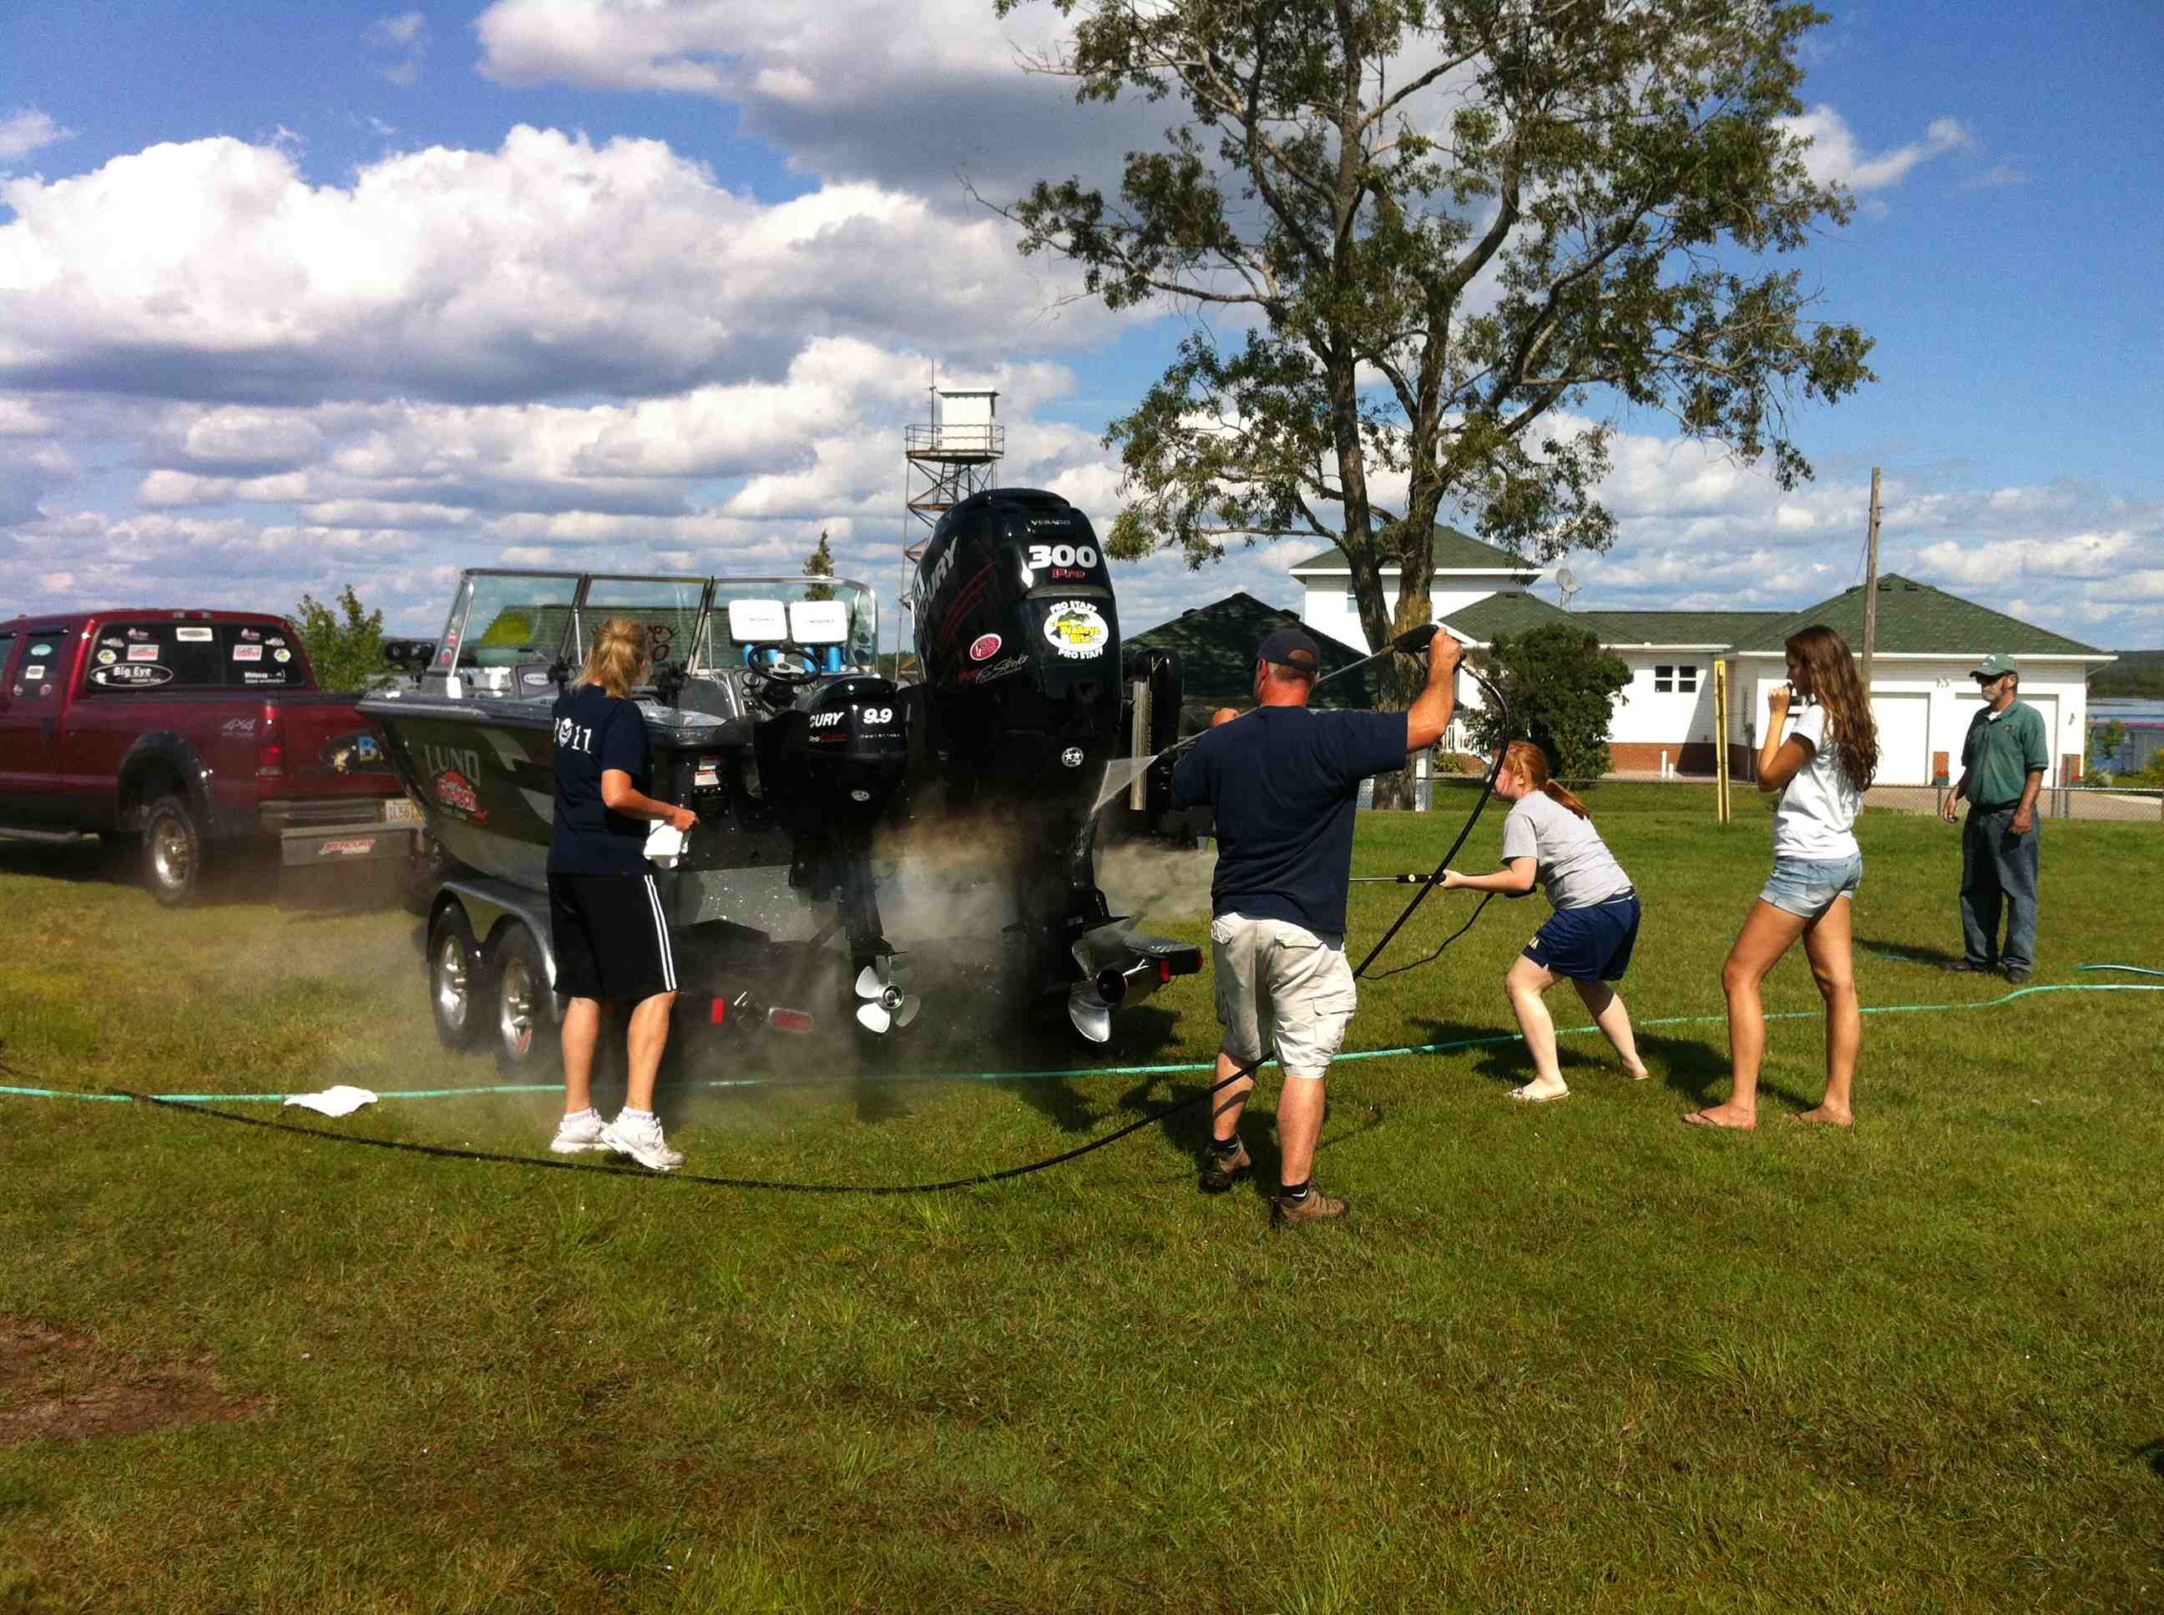
Support Groups
Wide Range of Groups:
H.S. Sports Teams
Boy Scouts
4H
Fishing Teams/Clubs
Other School groups
Age Range: Typically 7 - 16 (with 3 Adults)
Group size 5 – 13 people
How to find?
Notes:
Wide range but mostly youth groups.
Generally not directly associated with tournament (ie not local fishing club) but usually assoc. via city council/board of tourism or other entity that is helping to put on the tournament.
How to find groups is the golden question. Often asking those helping to organize the tournament at local level is the key.

Slide 4
Working with Support Groups
Our Goals:
Safety
Effective AIS prevention
Minimal Impact on Tournament
Their Goals:
Safe
Fundraising
Effective Service
Fun
Notes:
Critical to understand the our goals but also what motivates groups to come out and volunteer.
Best to find overlap of these goals but also to understand where they don’t. This can explain where challenges arise.
In general: All groups want a safe event and it’s our job to ensure the safety of the event. Most groups want to raise money, we can help but they need to be motivated. We want effective AIS but they don’t’ always understand this piece or other goals get in the way (having fun, raising more money) but we all want their service to be effective and this where we overlap. Groups need to have some level of fun or they won’t come back. We need them to have a minimal impact on tournament operations or WE won’t be invited back.

Slide 5
AIS Tournament BMP and Groups
Heavy focus on Post-Event Boat Wash
Hard to get involvement for pre-fishing inspection
Less involvement with Tournament Gear
Good
Inspect – Remove – Drain
Plan and Record
Better
“Good” + Cold Rinse
Use mild bleach or salt solution on all equipment
Best
“Better” + High Pressure Cold Rinse
Setup a pressure wash line for boats
Wash line with hot water
“Best” + Hot Pressure Rinse
Exceptional
Notes:
Mostly support groups implement the wash BMP but important to remember that there are others where they can contribute.
Ideally they would take up pre-fishing inspection but this is tough.
An “event” where they participate and can raise funds seems to be the current ‘hook’
Tournament organizers generally have their own staff deal with tournament gear – holding tanks, bags, release boat.

Slide 6
Fundraising & Service Element
Community Service Hours
Can Raise $100 - $500
Amount depends on group enthusiasm & marketing
Fundraising Tips:
Make Signs
Have charismatic marketers promote wash to boaters
Practice Message
Notes:
Most groups are motivated by the fundraising aspect though the service is important to the adults.
I stress that the group determine how much they raise and that anglers expect a quality job done quickly.

Slide 7
Prepping Volunteers
Communicate Pre-Event Information
What to expect
BMP Training
Event length
Where to meet and park
What to wear: Uniforms, Glasses, Closed shoes
What to bring: Drinking Water, Appropriate clothes, Signs
Notes:
Email or phone. IF you can do a pre-event training and review BMP’s.

Slide 8
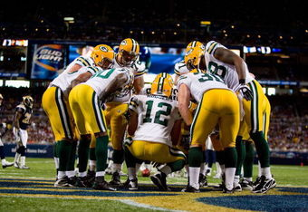
Onsite Orientation
Introductions & Sign-in
AIS Information
Goals for the day
Safety
Station Set-up & Roles
Equipment
Notes:
Each event starts with an onsite orientation with the support group
This includes everything on this list.
If they haven’t had the BMP/AIS training then we review the basics including:
What is AIS, What is it important to prevent, What can we do (BMP’s)
Review goals: Stay safe, reduce AIS for community, have fun or raise funds
Safety: 1. Review Trucks are moving,2. Roles help keep people safe, 3. ID what Adults can do vs. youth
Stations: Explain stations and review roles. Delegate roles.
Equipment: Review safety again and any logistics

Slide 9
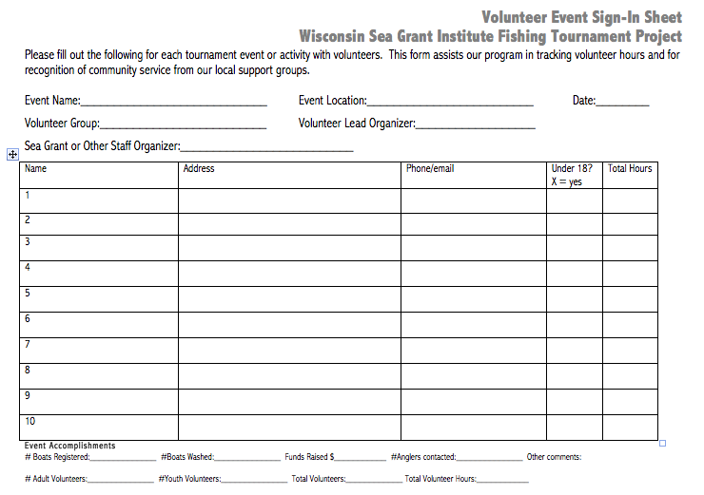
Staff organizer should fill in these sections
Notes:
At orientation the support groups need to sign-in.
This ensures you can keep accurate numbers and have contact info for later.
The volunteer manager can fill in the event details.

Slide 10
During Event
Stations
Safety
Monitor Wash Efficiency & Traffic
Check-in with Group Leader
Monitor Speed
Break for snacks
Encourage “marketing” by group
Notes:
The event requires some heads-up time. Be sure to not get locked into a single job but to monitor the entire process. This ensures safety and effectiveness.

Slide 11
Wash Station Set-up
Key Roles:
Traffic Director & Prompt Distribution
Inspector
Pressure Washer(s)
Marketers
Towelers

Slide 12
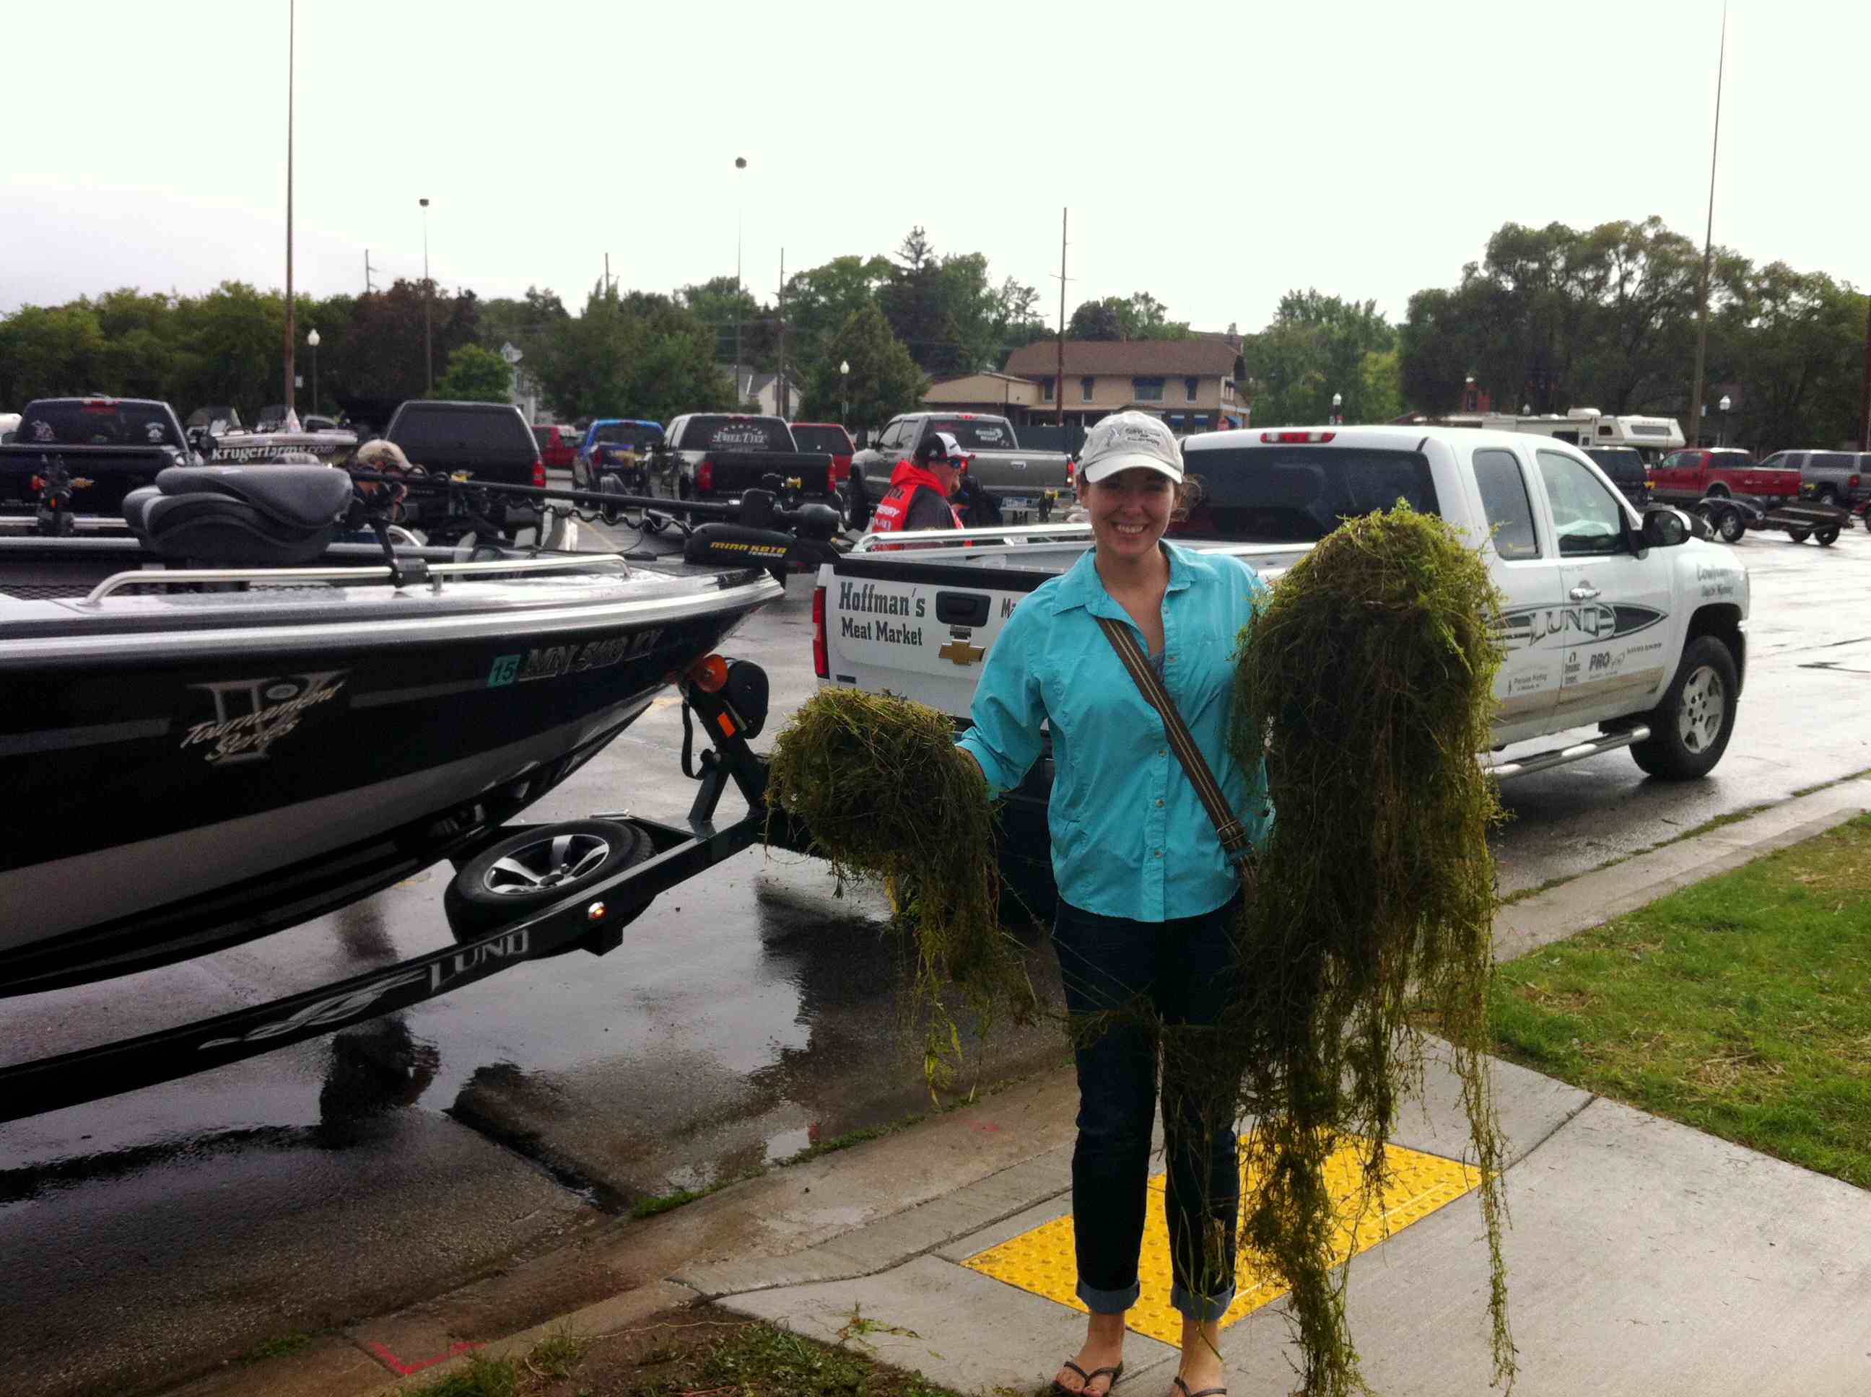
Inspection

Slide 13
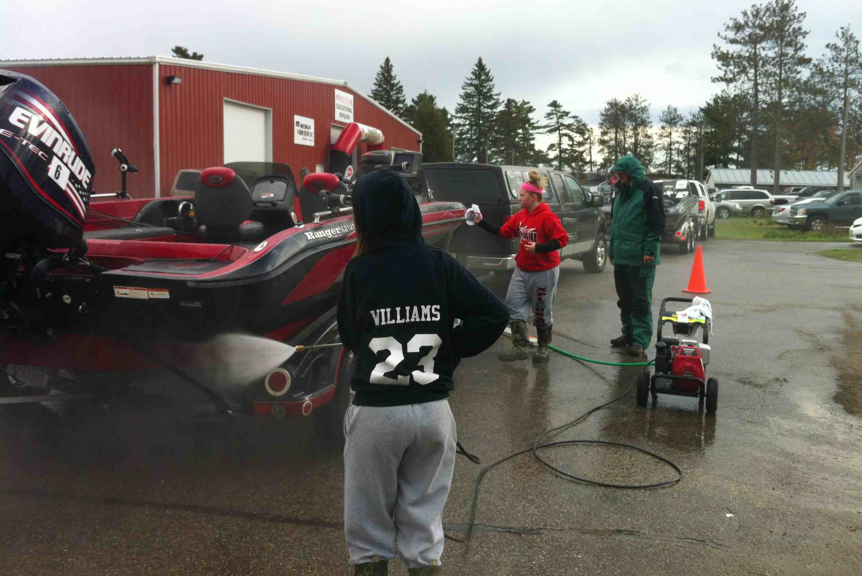
Traffic, Washer & Towel

Slide 14
End of Event
Thank everyone & Group photo!
Debrief & Ask for feedback
Clean equipment
Make sure everyone signed-in
Distribute “Prompts”
Complete volunteer form
Follow-up with Tournament staff
Notes:
End of event debrief. Gather everyone up. Provides closure and finishes remaining details.
Follow-up with everyone via email post event.

Slide 15
Questions

